Slide 1
Capstone Project-1
Medical diagnosis data set Team Members Vidur sharma-2210992524 Sukhpreet Singh-2210992416 Shubham Dhiman-2210992362 Shubham dhoni-2210992362

Slide 2
CONTENT
Problem Statement
Objective
Tools Used
Data Summary
Exploratory Data Analysis
Challenges
Recommendations
Conclusions
Q & A

Slide 3
PROBLEM STATEMENT
The healthcare industry faces the challenges of efficiently and accurately diagnosing medical conditions in a timely
manner. To address this challenge, the goal of this AI/ML project is to develop a robust and scalable medical diagnosis .
The system aims to leverage machine learning algorithm and artificial intelligence to analyze patient data,
symptom and diagnostic test result for the accurate identification and classification of various medical condition
The main key components and challenges could :Medical data comes in various formats , include structured data and unstructured data and the other one could be achieving high accuracy and reliability in medical diagnoses is crucial to
avoid misdiagnoses and ensure patient safety

Slide 4
OBJECTIVE
The main objective of medical diagnosis project is to leverage data and computational techniques to accurately and categorize disease or health conditions based non observed symptoms. The project aims to improve healthcare by providing timely and precise information to healthcare professional for effective decision making for patient care.

Slide 5
Tools Used
Jupyter Notebook is used as IDE.
Pandas and NumPy are used for Data Manipulation & Pre-processing and Mathematical functions respectively.
Exploratory data analysis is automated by data prep.
For visualization of the plots, Matplotlib, Seaborn, Plotty are used.
GitHub is used as version control system

Slide 6

DATA SUMMARY
Categorical Data
1.NAME OF PATIENT
2.BLOOD TYPE
3.GENDER
4.ROOM NO
Numerical Data
1.AGE
2.DATE OF ADMISSION
3.BILL AMOUNT
4.DISCHARGE DATE
Unique Data
1.ADMISSION NO

Slide 7
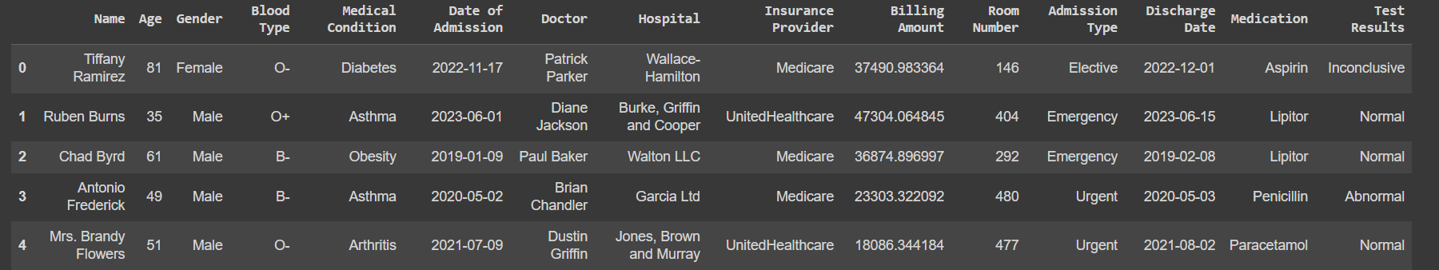
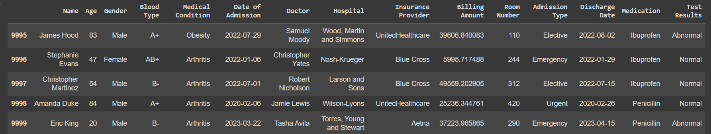
DATA SUMMARY
This is the medical diagnosis dataset first and the last view.

Slide 8
FEATURES DESCRIPTION
NAME: Name of the patient
AGE: Age of the patient
GENDER : Gender of the patient
BLOOD TYPE : Blood type of patient
MEDICAL CONDITION : Medical condition of patient
DATE OF ADMISSION : Date when patient is admitted
DR NAME : Name of doctor who treated the patient

Slide 9
FEATURES DESCRIPTION
HOSPITAL: Name of the hospital
INSURANCE PROVIDER: Name of the company providing insurence
BILLING AMOUNT: Amount to be paid
ROOM NO: Room no of patient
ADMISSION TIME: time of admission
DISCHARGE DATE: Date of discharge of patient
MEDICATION: Medicine used in treatment
TEST RESULT: Test report

Slide 10
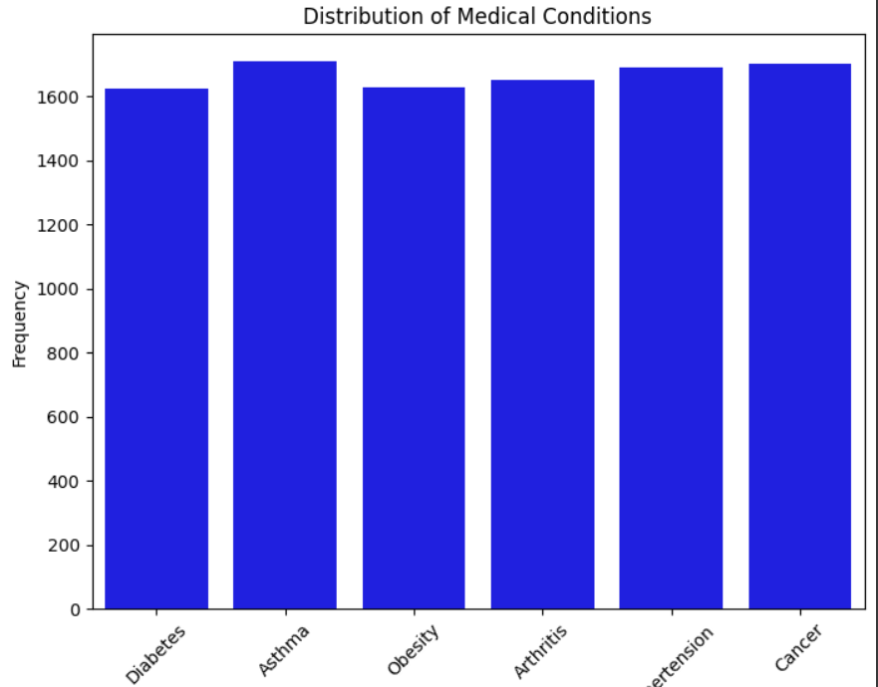
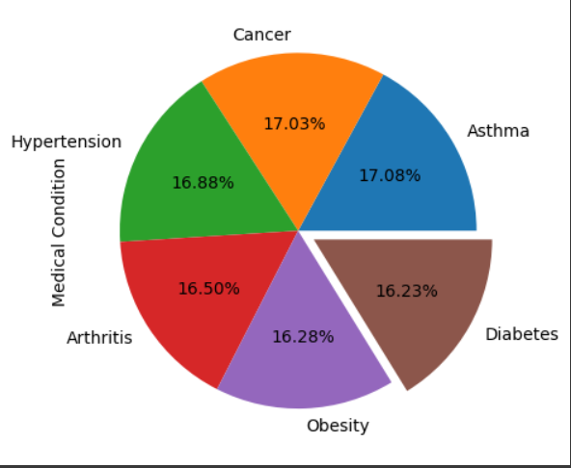
Analysis of the people suffering with different disease
Below plot on the left side is pie chart shows the percentage of disease .
And on the right side the there is no of people suffering from specific disease.

Slide 11
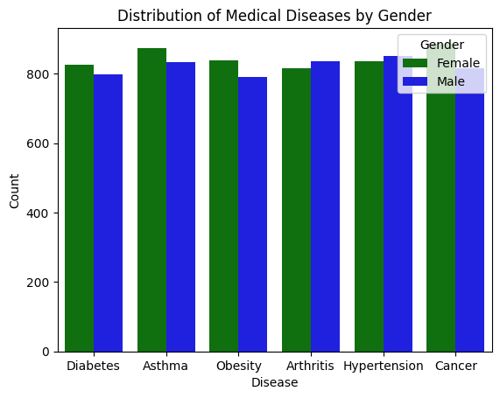
Distribution of medical diseases by gender
This bar graph show the spread of the diseases effecting male and female. The green bar show female and blue show male.

Slide 12
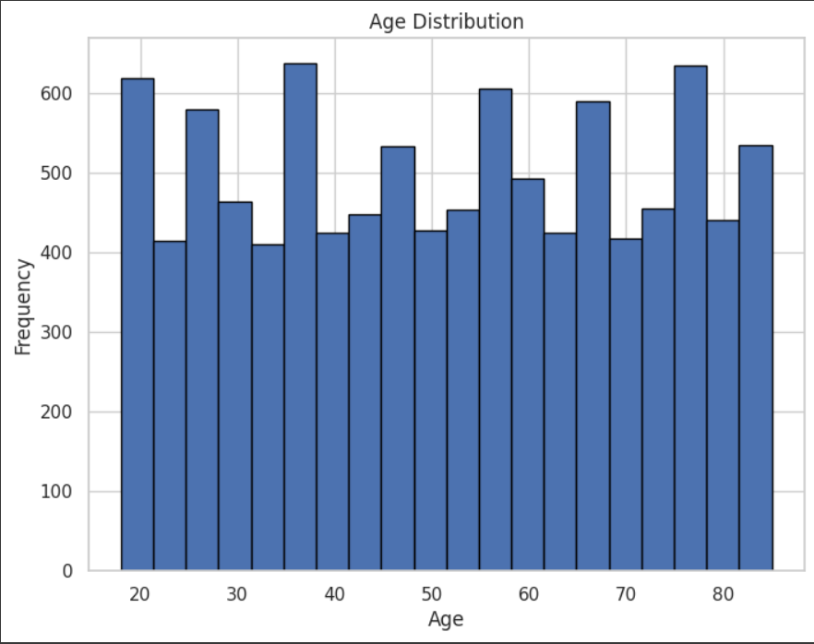
AGE DISTRIBUTION WITH FREQUENCE
This Histogram was chosen visualize the distribution as it effectively display the frequency of different age groups.

Slide 13
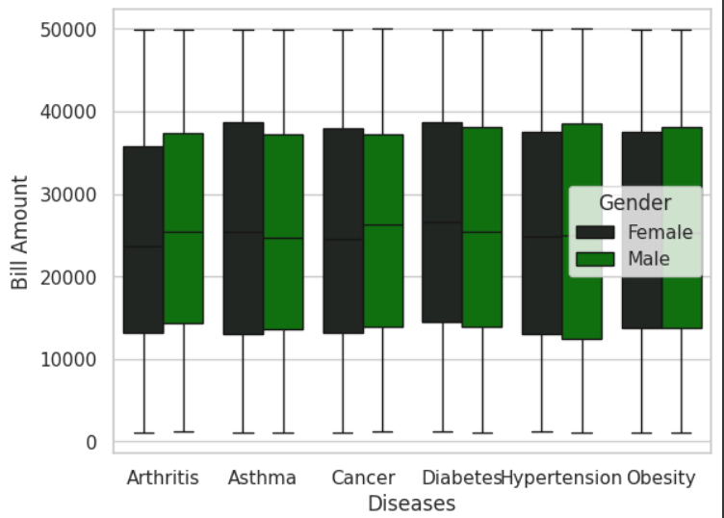
HOSPITAL BILLING AMOUNT
This graph show the billing amount of male female with there diseases.

Slide 14
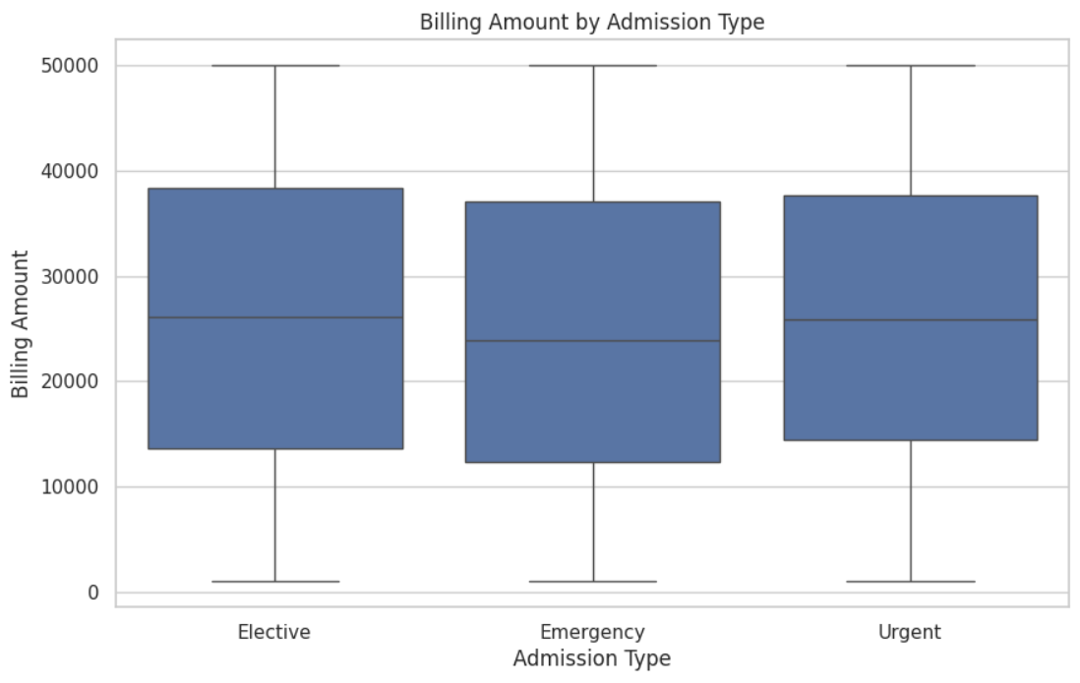

ADMISSION TYPE WITH BILLING AMOUNT
A Box plot efficiently compare billing amounts by admission type , showing median , quartiles and outlier.

Slide 15
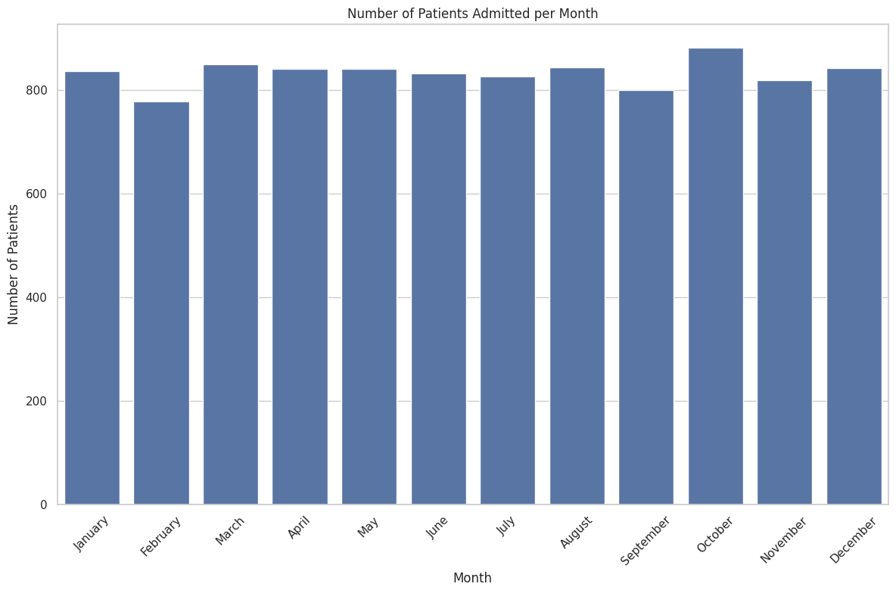
Number of patients admitted per month
The chat on “patient Admitted per month” reveals seasonal patterns , long term trends , and peak admission months. It helps in resource allocation , forecasting patient volumes , and evaluating the effectiveness of market campagins or health policies.

Slide 16
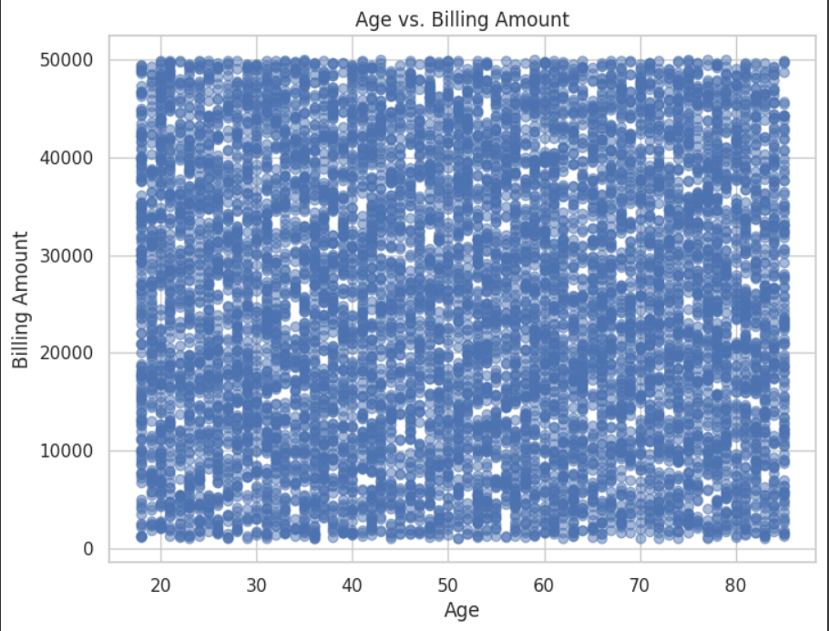
BILLING AMOUNT AND AGE
A scatter plot for “Age vs Billing Amount ” is chosen to analyse the relationship between these variable . It visually depicts patterns , outliers, and potential correlation, aiding in understanding if older patient tends to have higher bills

Slide 17
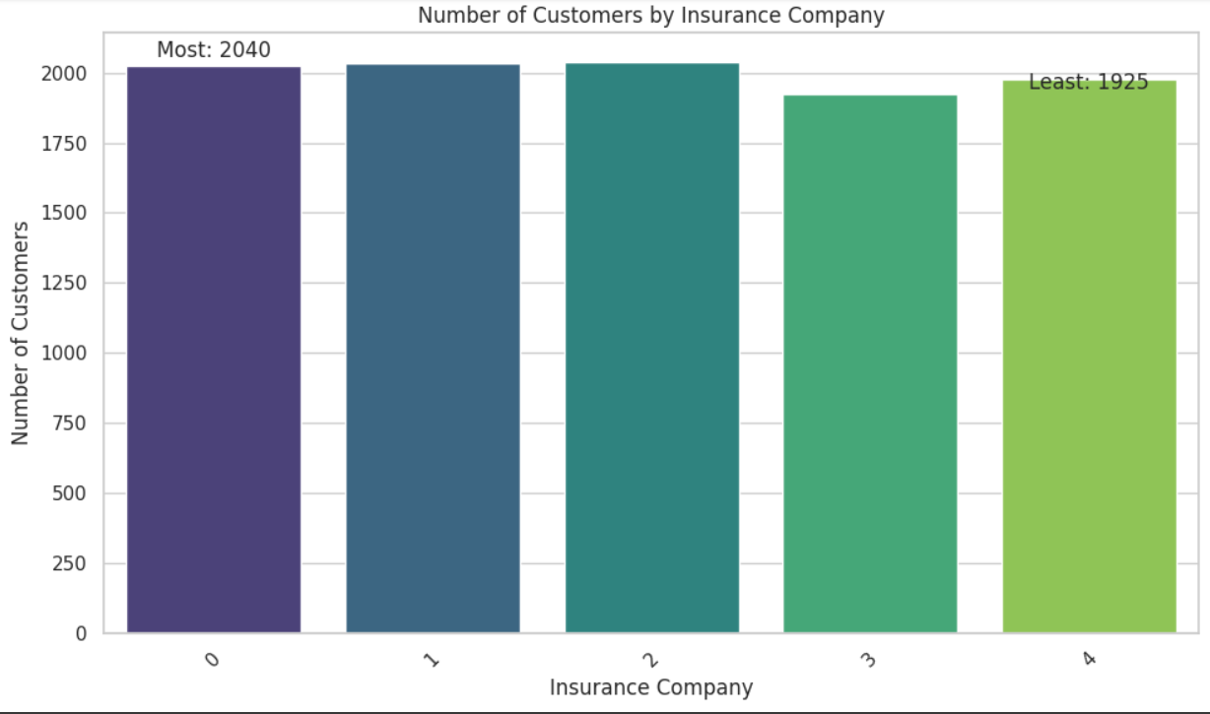
NUMBER OF CUSTOMER INSURED BY COMPANY
This chart display the customer distribution among insurance provider. It was chosen for its ability to compare the market share of each insurance company .s

Slide 18
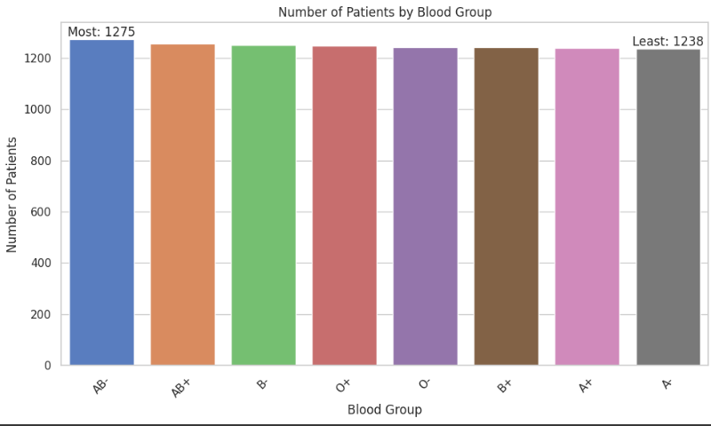
NUMBER OF PATIENT BY BLOOD GROUP
The “ number of patient by blood group ” chart is chosen to understand blood group distribution within the patient population. It aids in ensuring sufficient blood supply for emergencies.

Slide 19
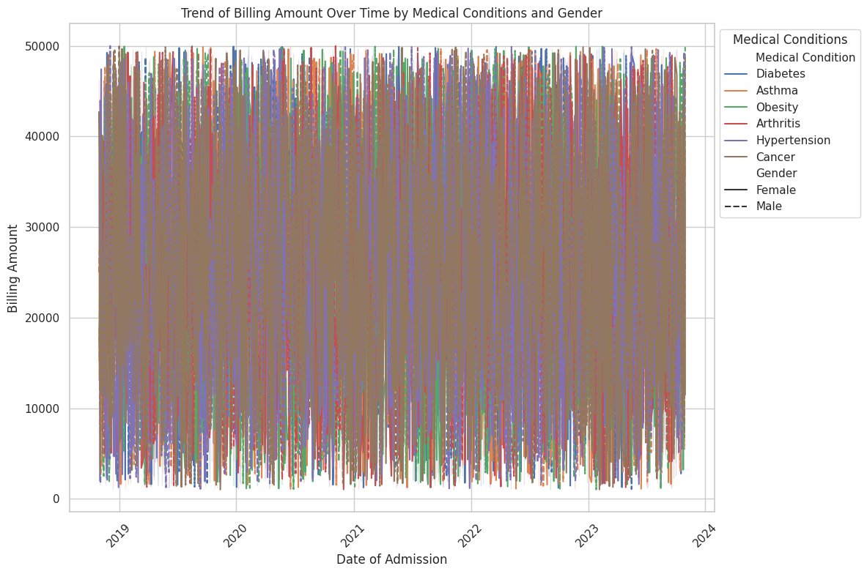
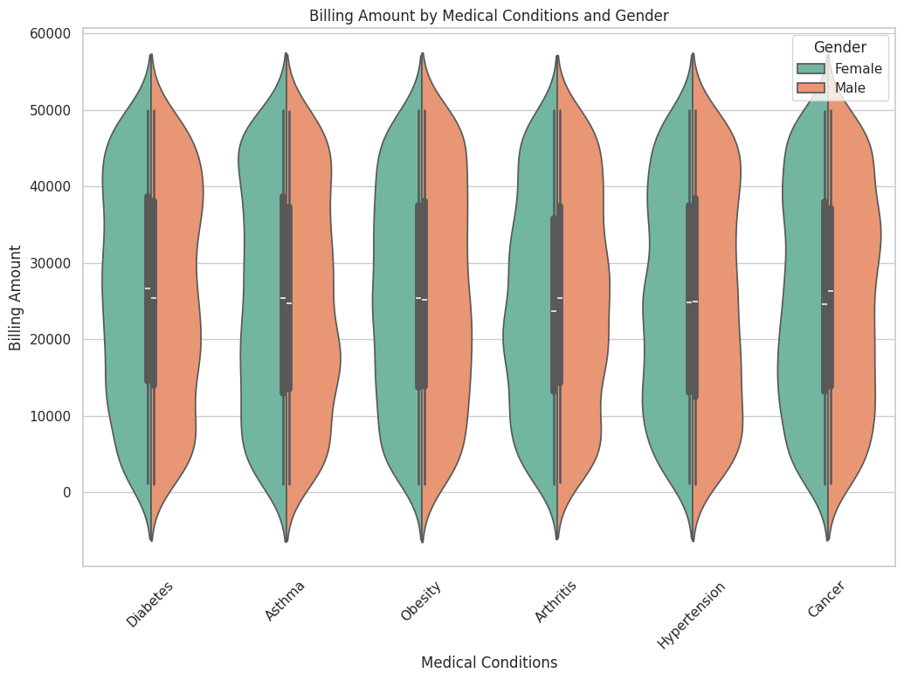
BILLING AMOUNT OVER TIME BY MEDICAL CONDITIONS AND GENDER
The line plot was chosen to illustrate the trend of billing amount over time for different medical conditions . This chart enables clear visualization of how billing varies across conditions

Slide 20
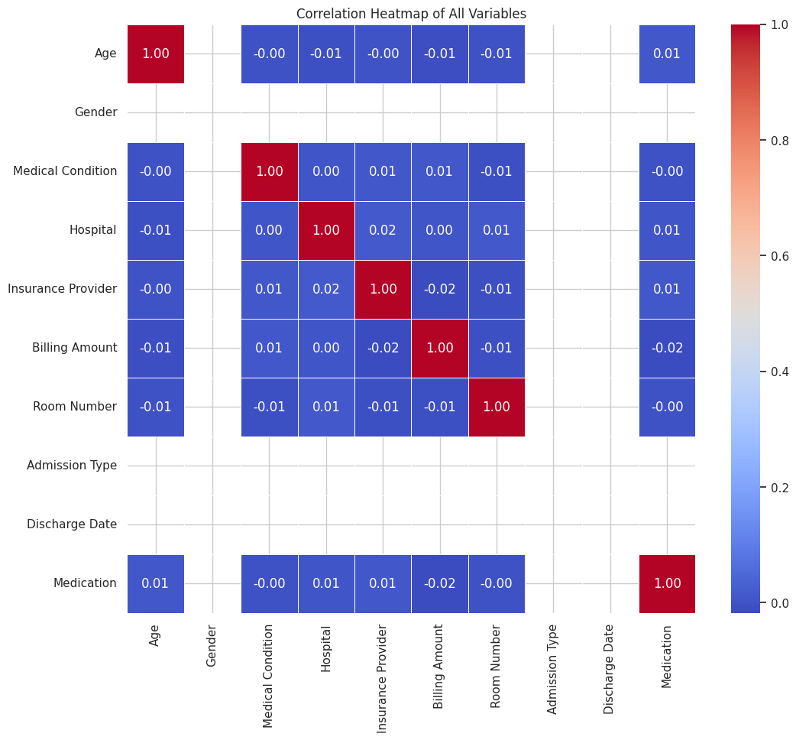
CORRELATION HEATMAP OF ALL VARIABLE
A Heatmap was chosen to explore the relationship between numeric variable due to its ability to visually represent the correlation matrix. The chart efficiently display the strength and direction of relationship, aiding in identifying patterns.

Slide 21
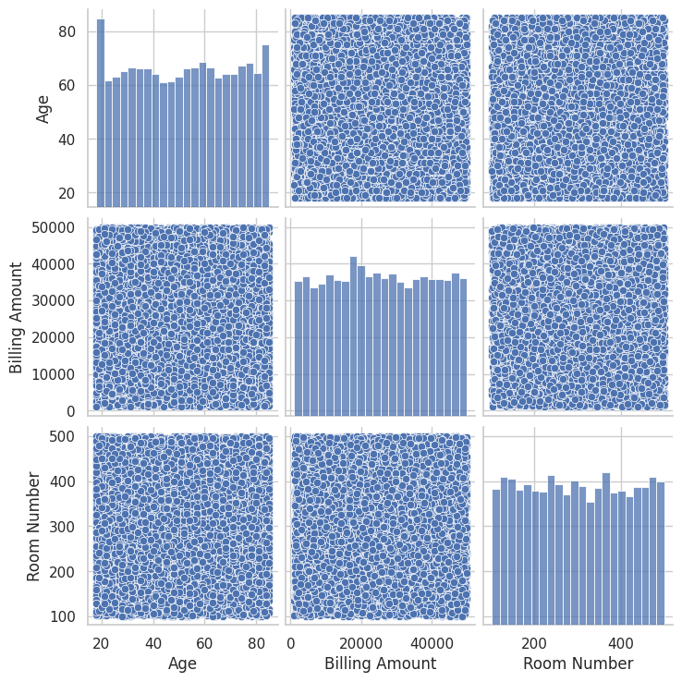
PAIR PLOT
A Pair plot was chosen to explore pairwise relationships between numeric variable as it offer a comprehensive view of interactions in a single plot.

Slide 22
Challenges
Ethical considerations regarding patient privacy and data security.
Interpretability of the model’s decisions , particularly dor complex deep learning models
Regulatory compliance with heath care standard and regulations

Slide 23
Recommendations
Ensure access to high quality and diverse heath dataset, incorporation electronic health records, medical imaging genomic information and patient demographics.
A comprehensive dataset enhance the accuracy and effectiveness of AI/ML health diagnosis models.
Adhere to ethical principles and regulatory standard in health care.
Protect patient privacy ,ensure secure data handling and comply with health care professionals.

Slide 24
Conclusions
The integration of AI/ML in medical diagnosis represent a transformative leap in healthcare . The marriage of advanced algorithms with vast datasets has ushered in a new era of precision and efficiency . Here are key points highlighting the significance
AI/ML efficiently processes vast amount of health care data, including diagnostic images, streaming decision making processes for health for health professionals
AI algorithms recommend personalized treatment plan based on patient specific data , considering genetic factor , medical history and responses to previous treatment.
While AI/ML in medical diagnosis holds great promise ,it is to recognize the importance of human expertise.

Slide 25
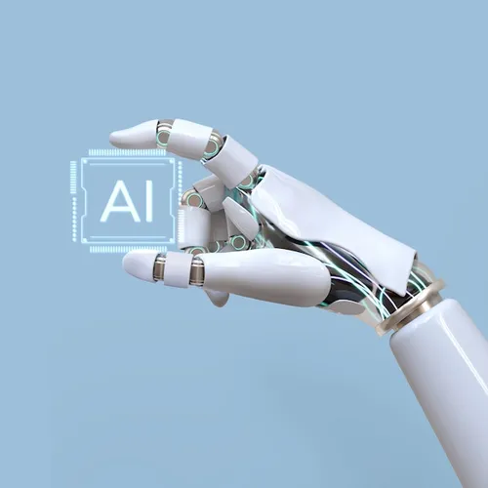
THANK YOU

